Slide 1
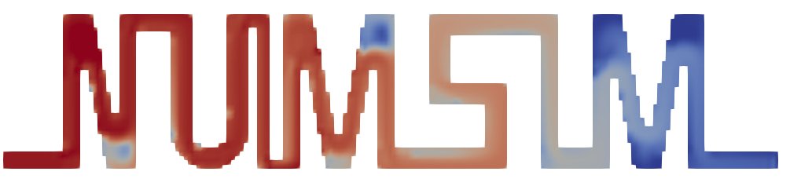

Institute for Parallel and Distributed Systems
Numerical Simulation
fluid solver for laminar flow with arbitrary geometries & heat flow
09.02.2021
[University of Stuttgart] [Stefania Scheurer, Marius Stach, Julian Franquinet]

Slide 2
Task and Implementation
Numerical Simulation

Slide 3
Heat Flow
Task
How to include temperature into code?
How to include temperature computation into solver?
Remaining modifications

Slide 4
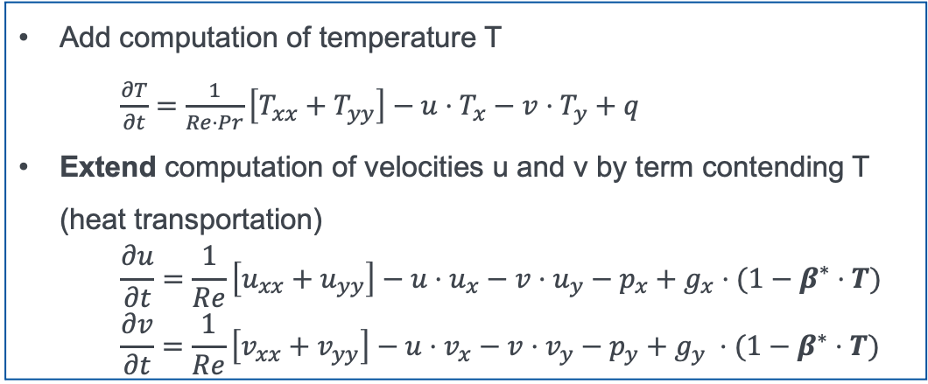
Heat Flow
Task
Add computation of temperature T
$\frac{∂T}{∂t}=\frac{1}{Re⋅Pr}\left[T_{xx}+T_{yy}\right]−u⋅T_{x}−v⋅T_{y}+q$
Extend computation of velocities u and v by term contending T (heat transportation)
$$\frac{∂u}{∂t}=\frac{1}{Re}\left[u_{xx}+u_{yy}\right]−u⋅u_{x}−v⋅u_{y}−p_{x}+g_{x}⋅(1−β^{∗}⋅T)$$
$$\frac{∂v}{∂t}=\frac{1}{Re}\left[v_{xx}+v_{yy}\right]−u⋅v_{x}−v⋅v_{y}−p_{y}+g_{y} ⋅(1−β^{∗}⋅T)$$
How to include temperature into code?
How to include temperature computation into solver?
Remaining modifications

Slide 5
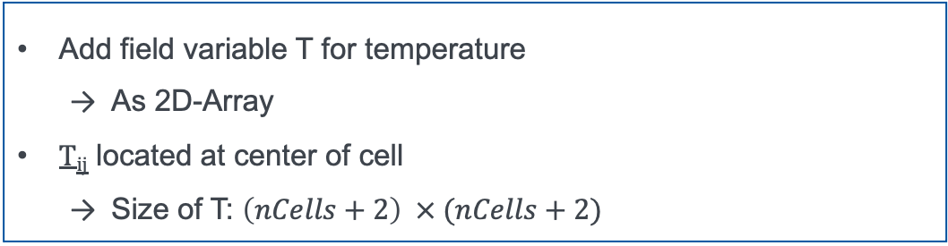
Heat Flow
Task
How to include temperature into code?
Add field variable T for temperature
As 2D-Array
T_{ij} located at center of cell
Size of T: $\left(nCells+2\right) × (nCells+2)$
How to include temperature computation into solver?
Remaining modifications

Slide 6
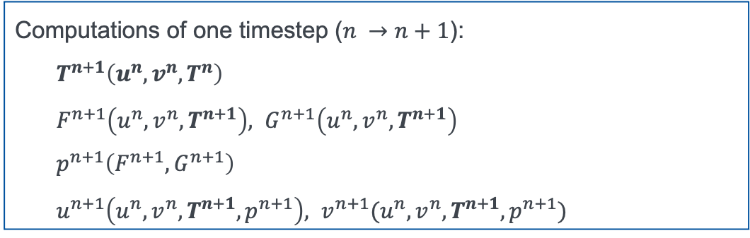
Heat Flow
Task
How to include temperature into code?
How to include temperature computation into solver?
Computations of one timestep ($n →n+1$):
$$T^{n+1}\left(u^{n}, v^{n}, T^{n}\right)$$
$F^{n+1}\left(u^{n}, v^{n}, T^{n+1}\right),$ $G^{n+1}\left(u^{n}, v^{n}, T^{n+1}\right)$
$$p^{n+1}\left(F^{n+1}, G^{n+1}\right)$$
$u^{n+1}\left(u^{n}, v^{n}, T^{n+1}, p^{n+1}\right),$ $v^{n+1}(u^{n}, v^{n}, T^{n+1}, p^{n+1})$
Remaining modifications

Slide 7
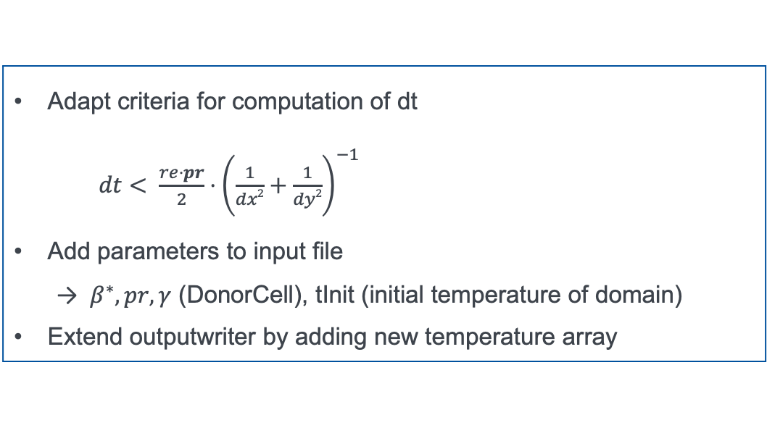
Heat Flow
Task
How to include temperature into code?
How to include temperature computation into solver?
Remaining modifications
Adapt criteria for computation of dt
$dt< \frac{re⋅pr}{2}⋅{\left.\left(\frac{1}{dx2}+\frac{1}{dy2}\right.\right)}^{−1}$
Add parameters to input file
$β^{∗}, pr, γ$ (DonorCell), tInit (initial temperature of domain)
Extend outputwriter by adding new temperature array

Slide 8
Arbitrary Geometries and Obstacles
Underlying concept: flag matrix
How to include “real” boundary conditions?
How to apply boundary conditions at obstacles?
How to combine obstacles and temperature?
Remaining modifications

Slide 9
Arbitrary Geometries and Obstacles
Underlying concept: flag matrix
Every cell assigned to type: FLUID, OBJECT, EMPTY
Computation only for celltype FLUID
Application of boundary conditions for celltype OBJECT:
⚠️ only NOSLIP boundary conditions for obstacles/objects
Skip for celltype EMPTY
How to include “real” boundary conditions?
How to apply boundary conditions at obstacles?
How to combine obstacles and temperature?
Remaining modifications

Slide 10
Arbitrary Geometries and Obstacles
Underlying concept: flag matrix
How to include “real” boundary conditions?
1D-Arrays for each boundary (bottom, top, left, right)
One array each for boundary condition type and value
1D-Array conceivable as mix of INFLOW, OUTFLOW, NOSLIP
How to apply boundary conditions at obstacles?
How to combine obstacles and temperature?
Remaining modifications

Slide 11
Arbitrary Geometries and Obstacles
Underlying concept: flag matrix
How to include “real” boundary conditions?
How to apply boundary conditions at obstacles?
Only NOSLIP, but different computation depending on FLUID surroundings of OBJECT cell
OBJECT subdivided into types:
-LEFT, -RIGHT, -TOP, -BOTTOM;
-TOPLEFT, -TOPRIGHT, -BOTTOMLEFT, -BOTTOMRIGHT
How to combine obstacles and temperature?
Remaining modifications

Slide 12
Arbitrary Geometries and Obstacles
Underlying concept: flag matrix
How to include “real” boundary conditions?
How to apply boundary conditions at obstacles?
How to combine obstacles and temperature?
Objects can be heated or isolated
Two additional matrices for temperature boundary condition type (heated or isolated) and value (if heated)
Temperature at “real“ boundaries: extend 1D-Arrays by boundary type and value
Remaining modifications

Slide 13
Arbitrary Geometries and Obstacles
Underlying concept: flag matrix
How to include “real” boundary conditions?
How to apply boundary conditions at obstacles?
How to combine obstacles and temperature?
Remaining modifications
Outputwriter uses staggered grid to write .vts files
EMPTY cells are blanked
Modified input .txt file for boundaries and obstacles necessary

Slide 14
Input File for Boundaries and Obstacles
Numerical Simulation

Slide 15
How to define boundary condtion types and values?
Input File: Example
{
Type= Bottombound
Velocity= Dirichlet; 0; 0
Pressure= Neumann; 0
Temperature= Neumann; 0
Position = 0; 1
}
location of boundary
boundary type& values (u;v)
boundary type and value (p)
boundary type and value (T)
physical starting and end value

Slide 16
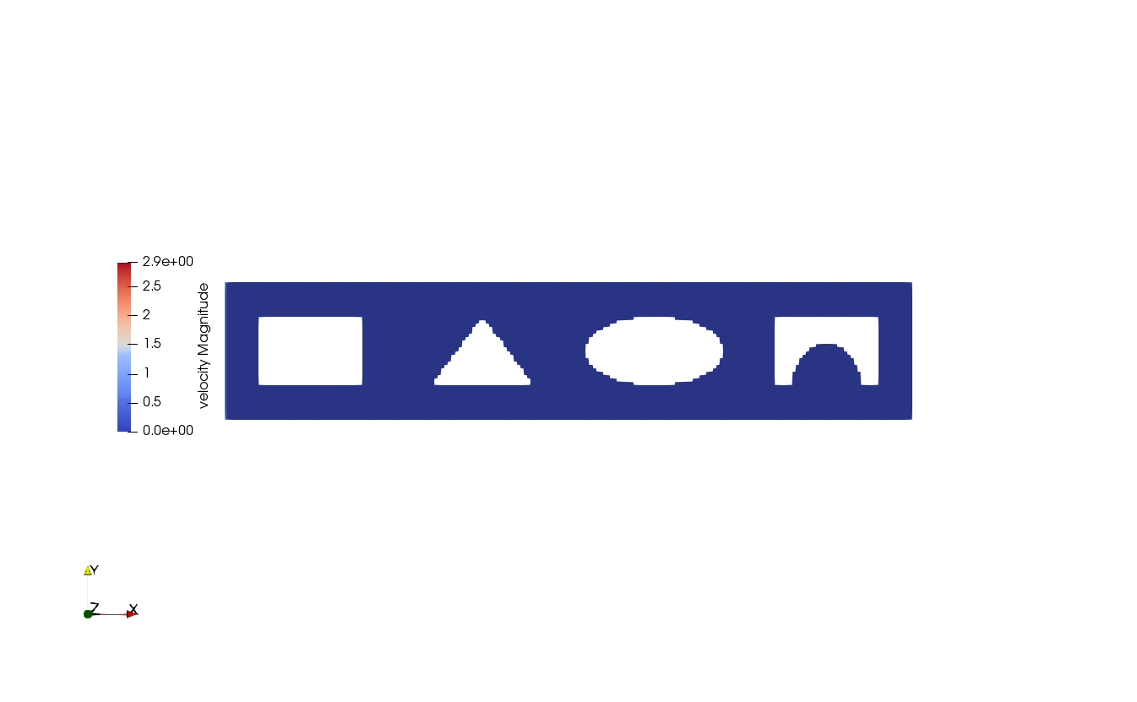
How to define obstacles?
Input File: Example
{
Shape = Rectangle
Position = 0; 0; 1; 1
Temperature = Dirichlet; 1
}
Shape of obstacle
Lower left and upper right corner
Temperature type and value
{
Shape = Triangle
Position = 0; 0; 0; 1; 0.5; 1
Temperature = Dirichlet; 5
}
Shape of obstacle
Corners of triangle
Temperature type and value
{
Shape = Ellipse
Position = 1; 1; 0.8; 0.5
Temperature = Neumann; 0
Type = Fluid
}
Shape of obstacle
Center and halfaxes
Temperature type and value
Fluid type to cut out shape of obstacle

Slide 17
Examples
Numerical Simulation

Slide 18
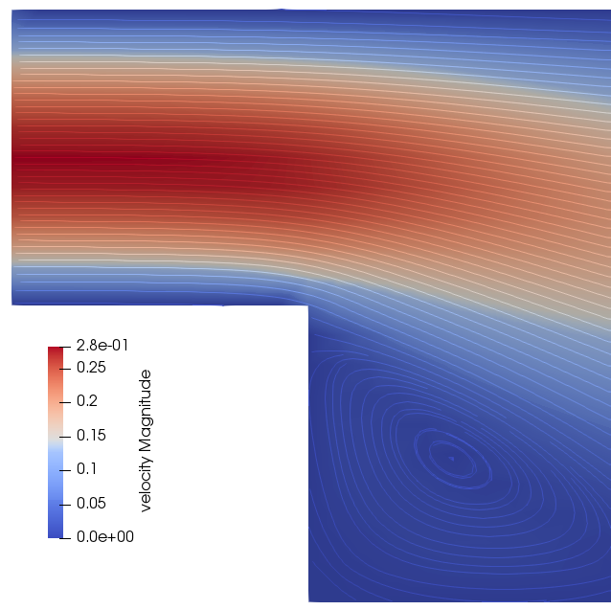
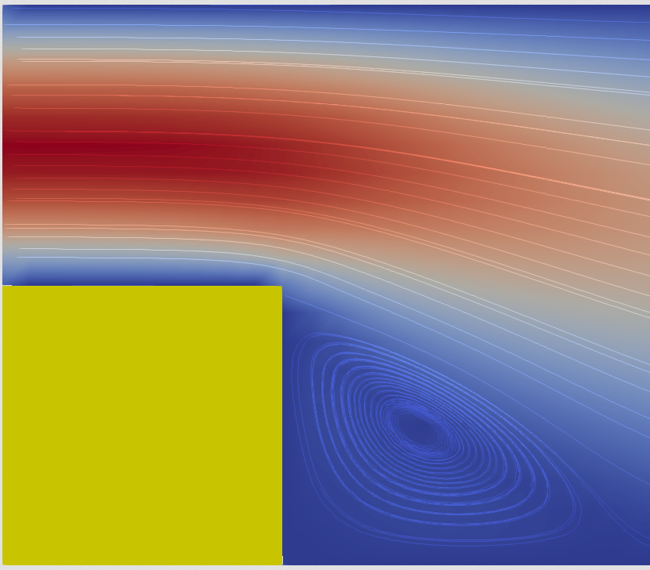
Channel with a Step: Comparison for Obstacles
Settings
physSize: 10x2
nCells: 100x20
endTime: 500s
Our Solver
Other Solver

Slide 19
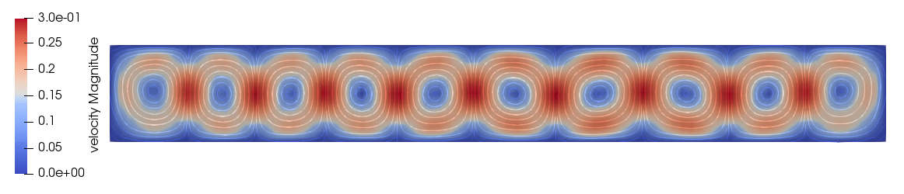
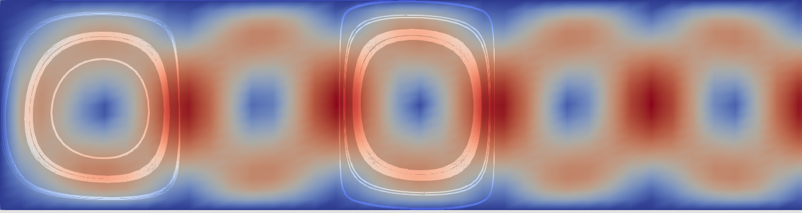
Rayleigh-Benard: Comparison for Heat Flow
Our Solver
Other Solver
Settings
physSize: 8x1
nCells: 80x20
endTime: 100s

Slide 20
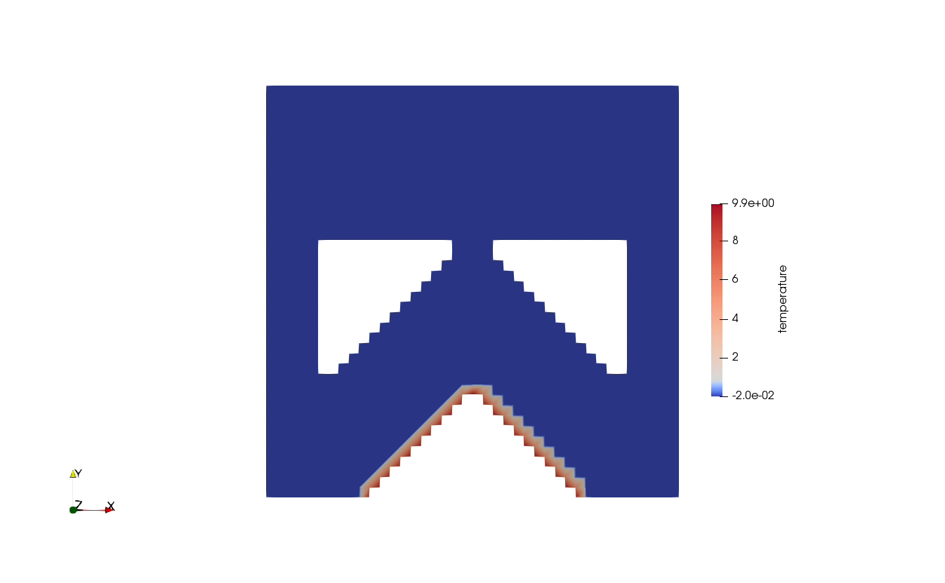
Fountain: Combination of Obstacles and Heat Flow
Settings
physSize: 2x2
nCells: 40x40
endTime: 20s

Slide 21
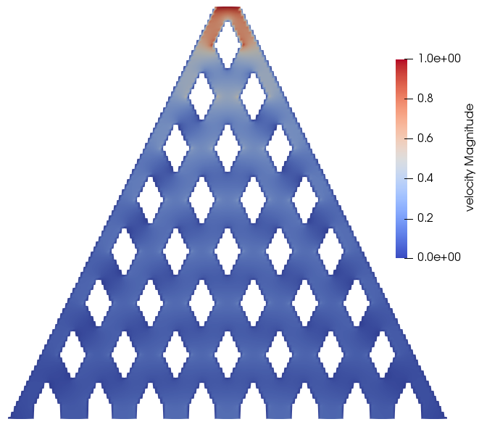
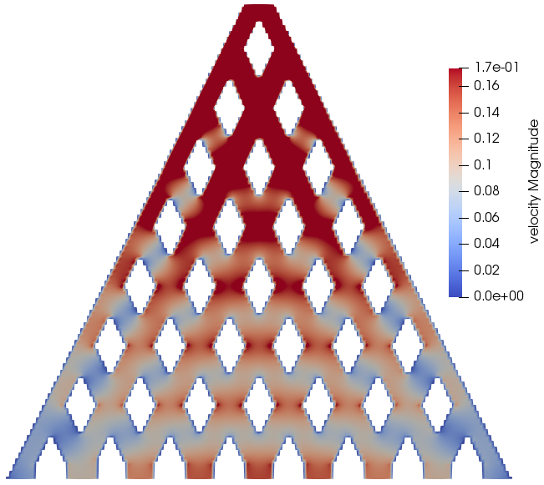
Beanmachine
Settings
physSize: 34x32
nCells: 170x160
endTime: 0.05s

Slide 22
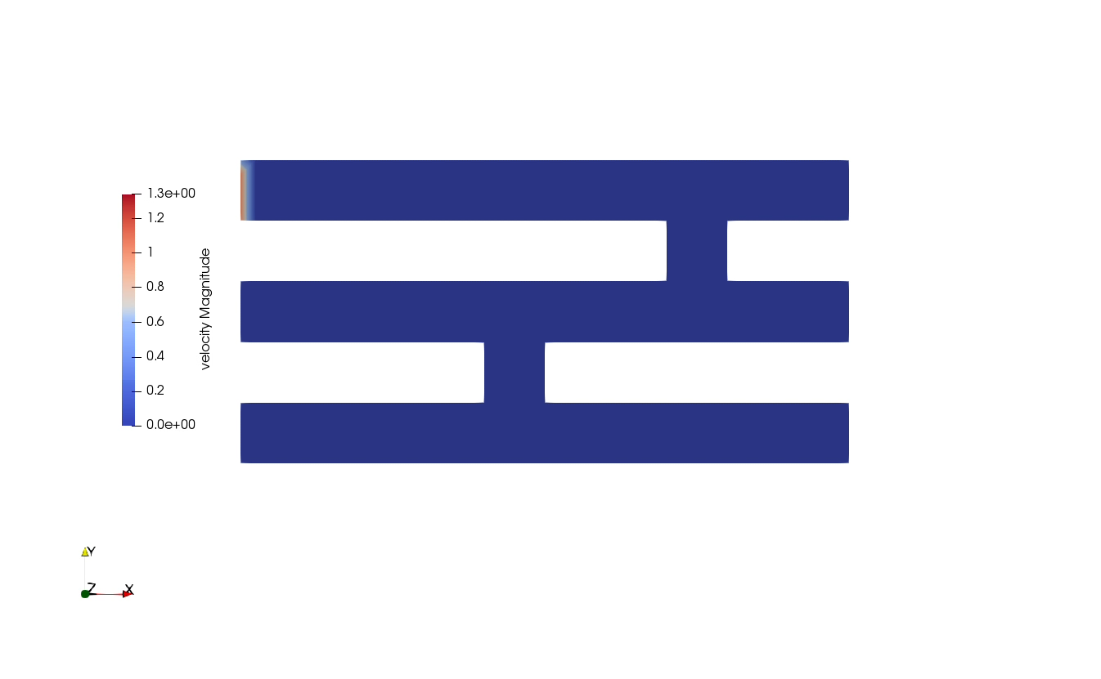
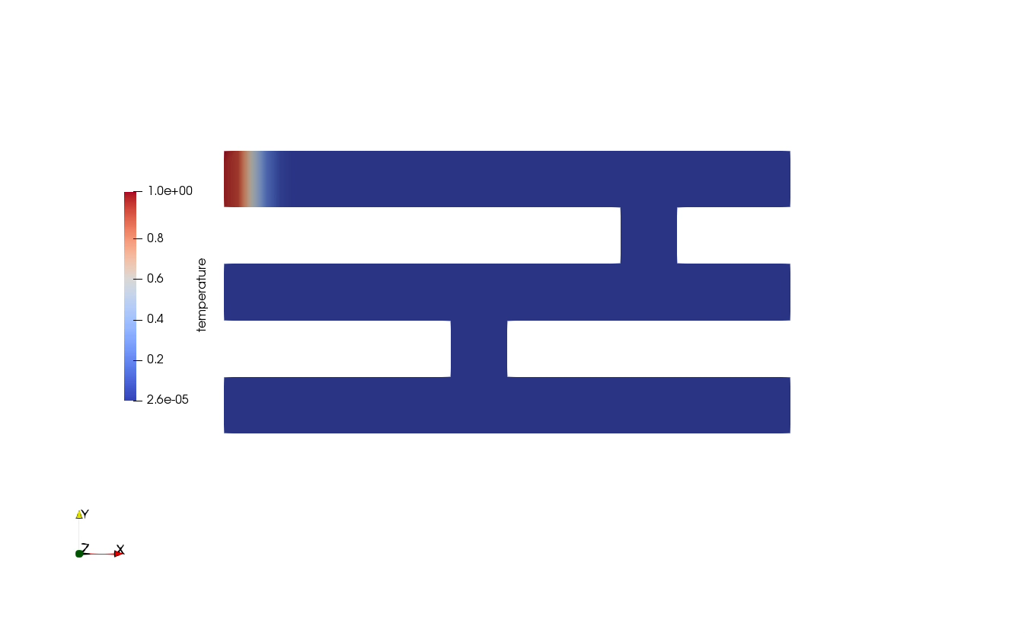
Labyrinth
Velocity
Settings
physSize: 5x2
nCells: 40x20
endTime: 50s
Temperature

Slide 23

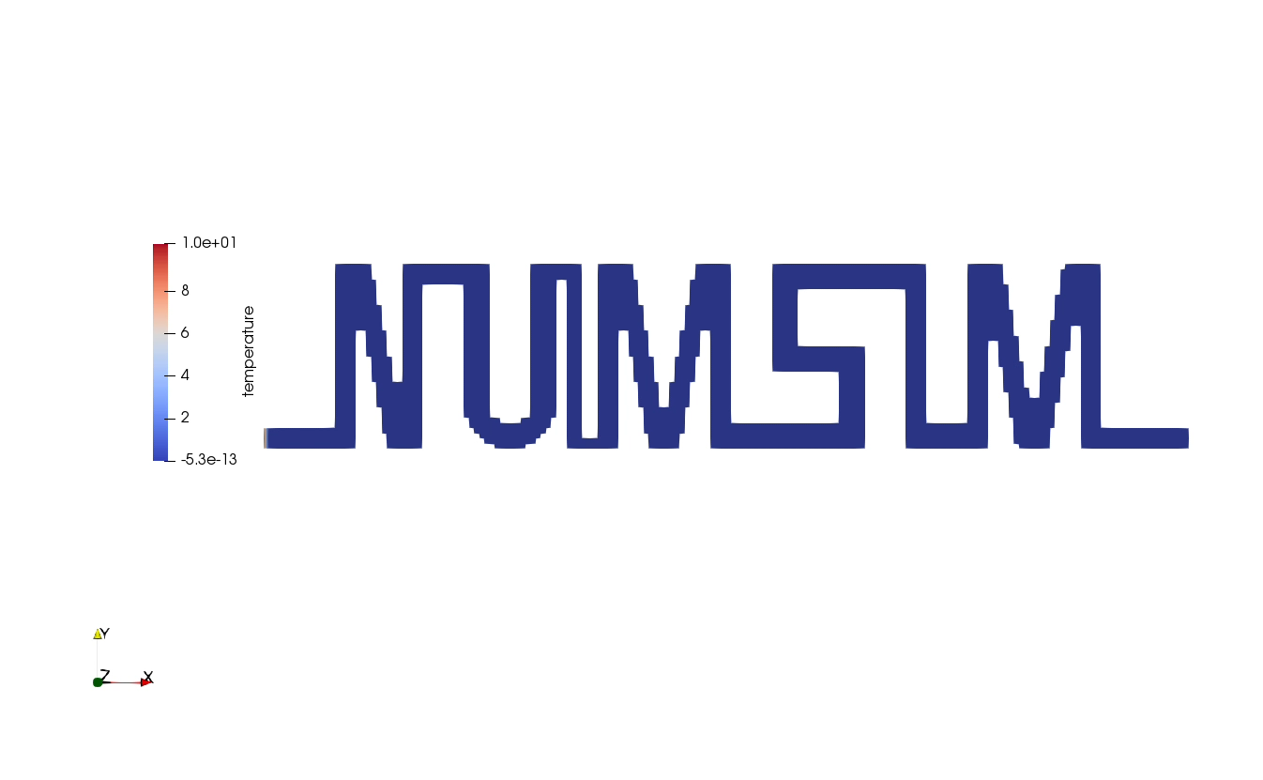
NumSim Flow
Settings
Velocity
physSize: 15x5
nCells: 180x60
endTime: 20s
Temperature

Slide 24
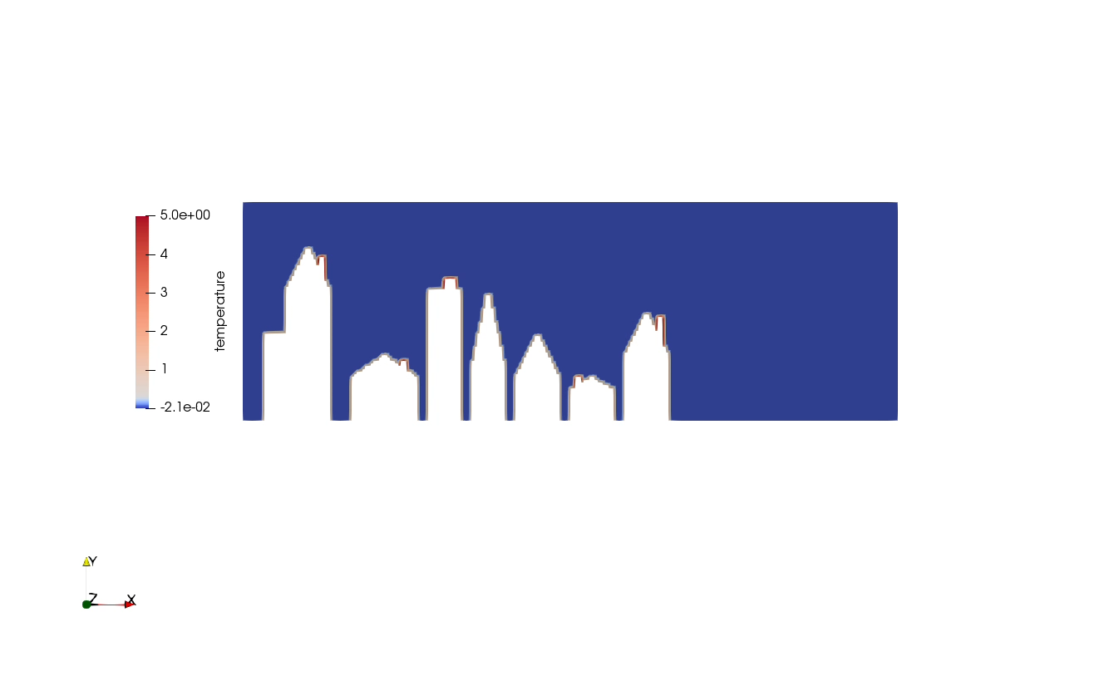
City
Settings
physSize: 15x5
nCells: 240x80
endTime: 10s

Slide 25
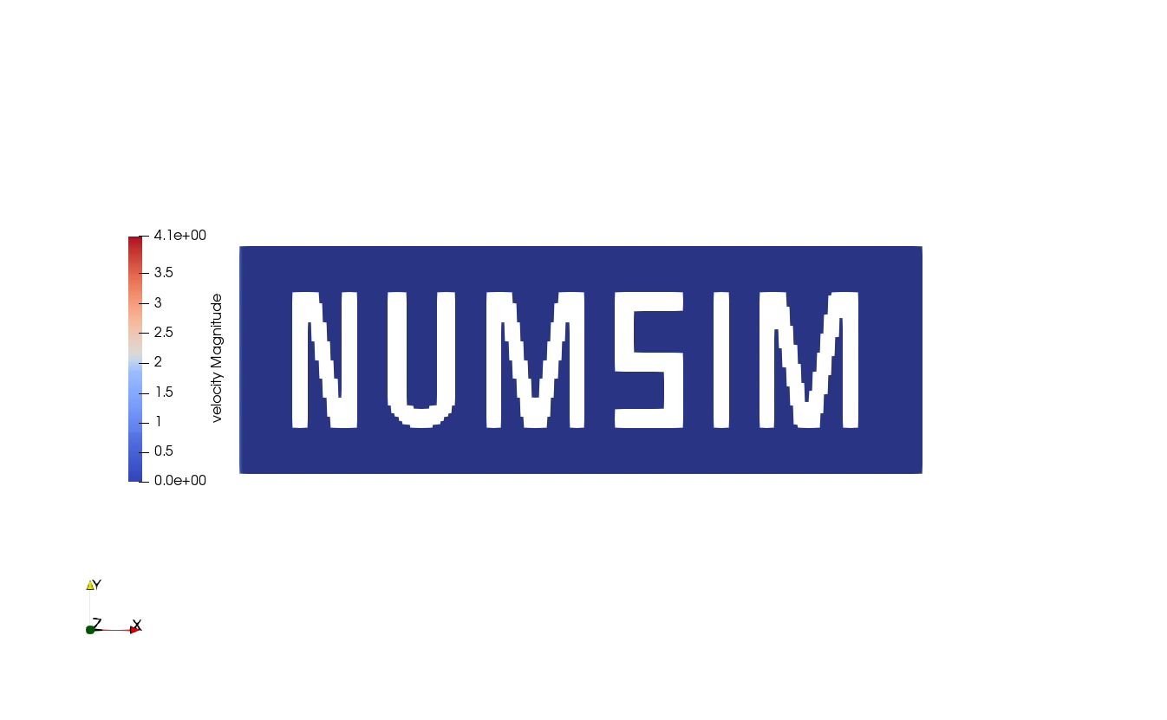
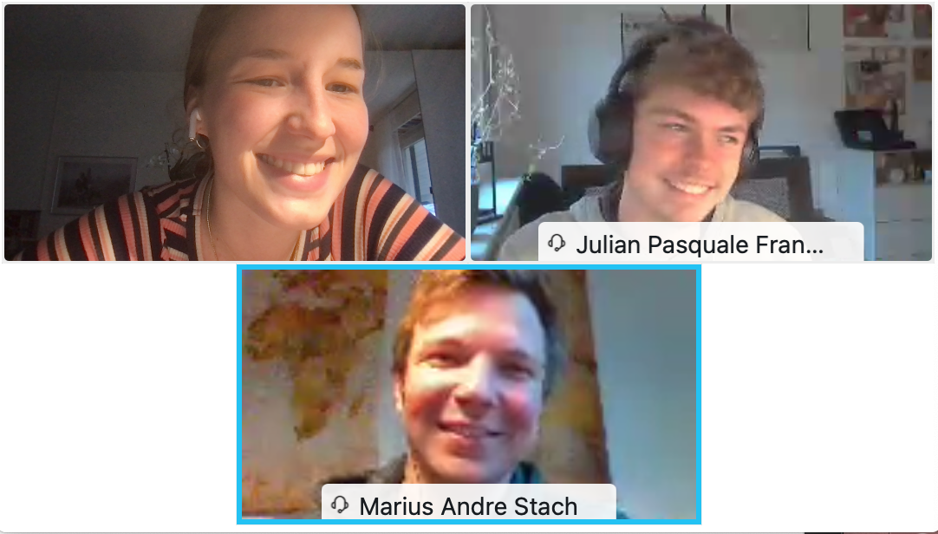
Institute for Parallel and Distributed Systems
Stefania Scheurer, Marius Stach, Julian Franquinet
University of Stuttgart
Institute for Parallel and Distributed Systems

Slide 26
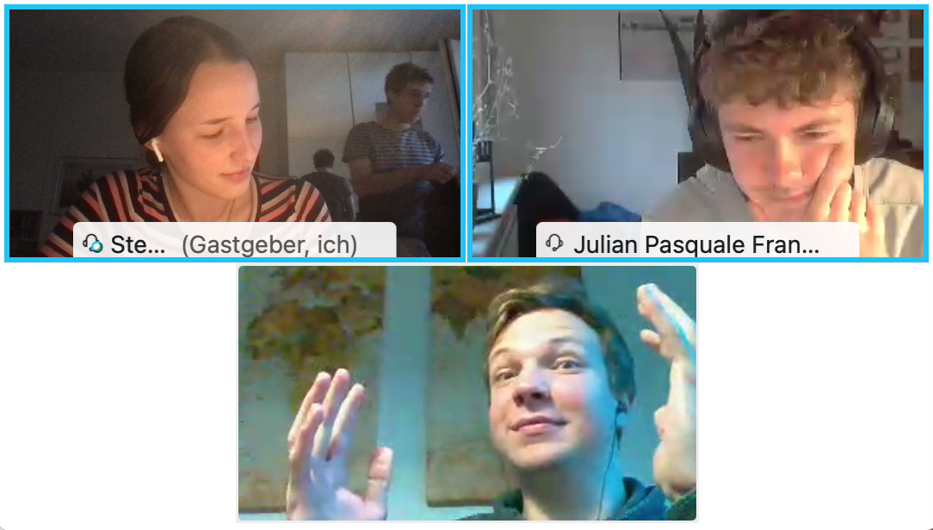
Institute for Parallel and Distributed Systems
Stefania Scheurer, Marius Stach, Julian Franquinet
University of Stuttgart
Institute for Parallel and Distributed Systems

Slide 27
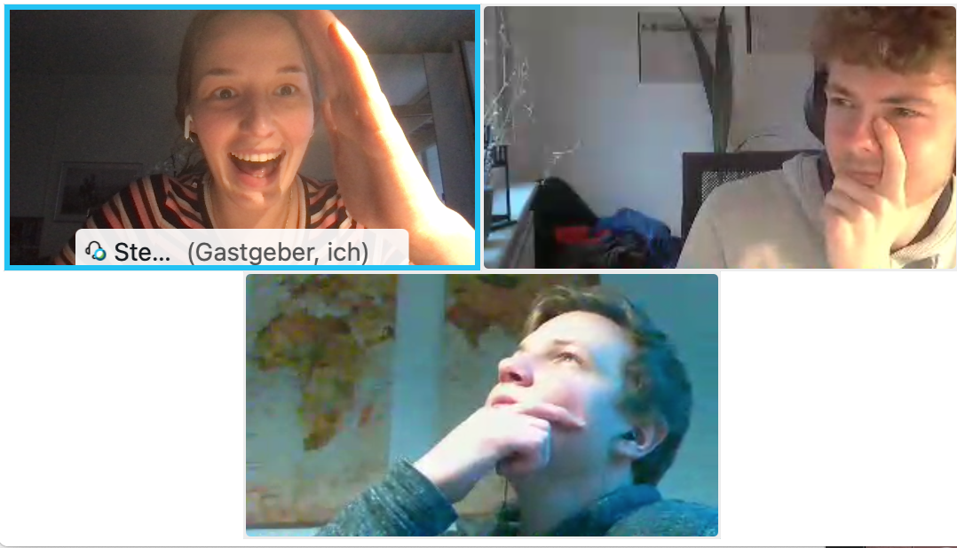
Institute for Parallel and Distributed Systems
Stefania Scheurer, Marius Stach, Julian Franquinet
University of Stuttgart
Institute for Parallel and Distributed Systems

Slide 28
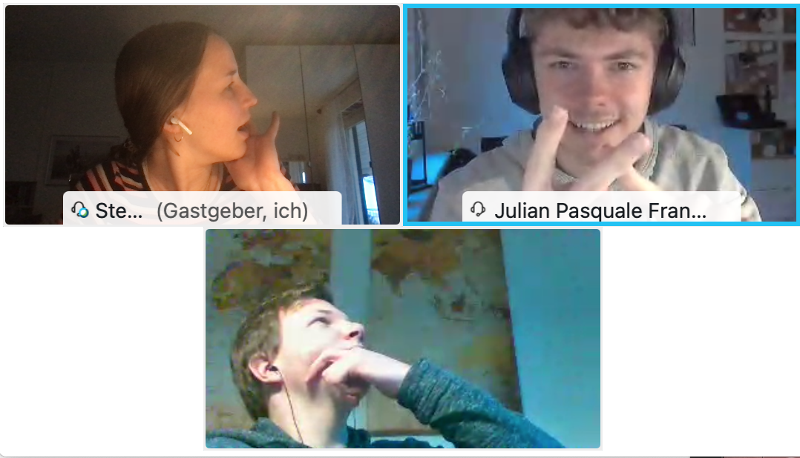
Institute for Parallel and Distributed Systems
Stefania Scheurer, Marius Stach, Julian Franquinet
University of Stuttgart
Institute for Parallel and Distributed Systems

Slide 29
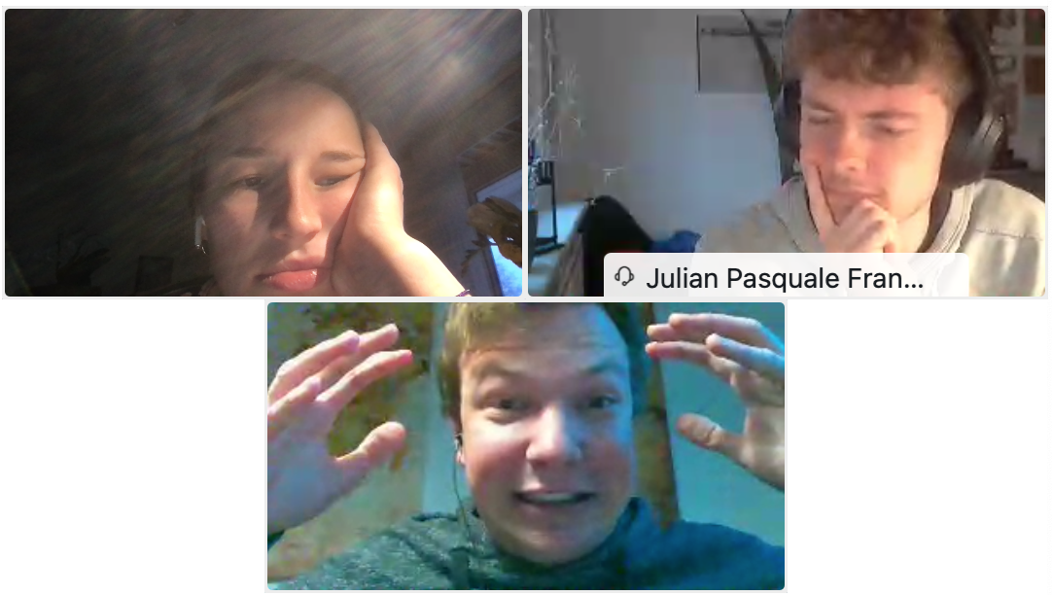
Institute for Parallel and Distributed Systems
Stefania Scheurer, Marius Stach, Julian Franquinet
University of Stuttgart
Institute for Parallel and Distributed Systems

Slide 30
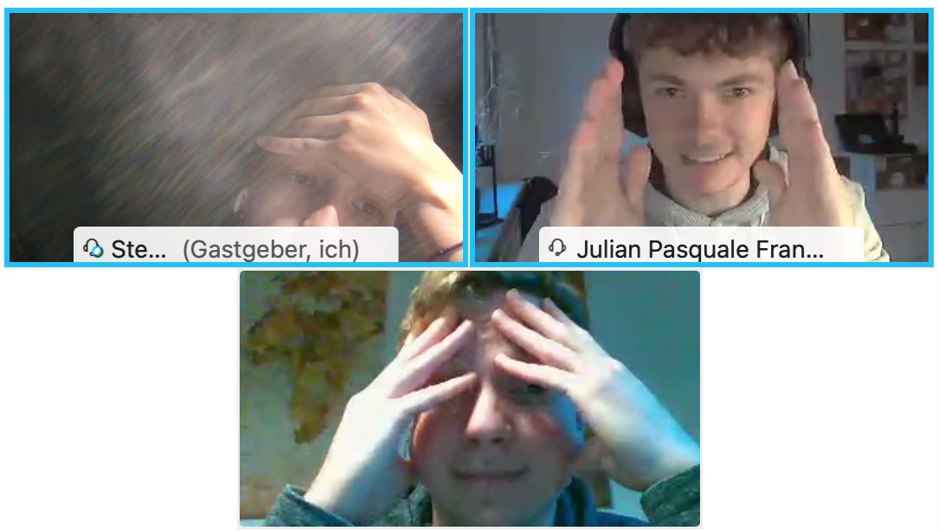
Institute for Parallel and Distributed Systems
Stefania Scheurer, Marius Stach, Julian Franquinet
University of Stuttgart
Institute for Parallel and Distributed Systems

Slide 31
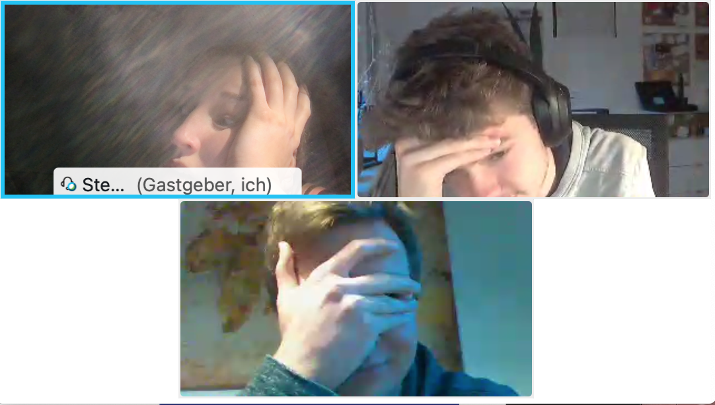
Institute for Parallel and Distributed Systems
Stefania Scheurer, Marius Stach, Julian Franquinet
University of Stuttgart
Institute for Parallel and Distributed Systems

Slide 32
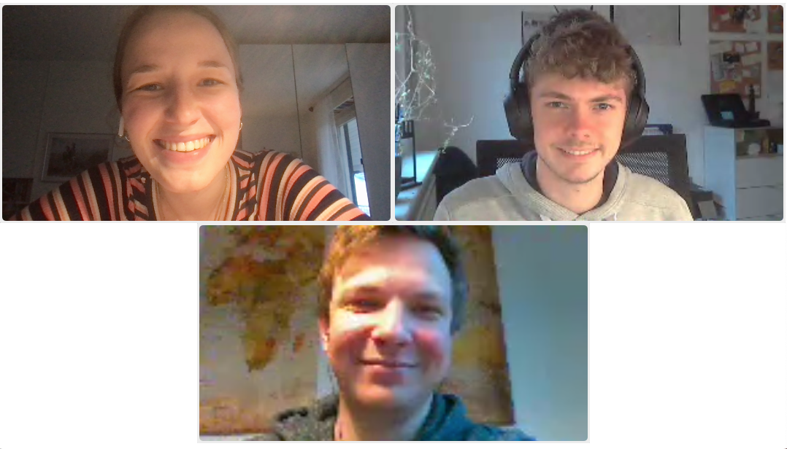
Institute for Parallel and Distributed Systems
Stefania Scheurer, Marius Stach, Julian Franquinet
University of Stuttgart
Institute for Parallel and Distributed Systems

